Slide 1


God BLESS FxA
Sai Prashanth Chandramouli
Firefox Accounts
irc: saipc
Github: TDA
E-mail: thatsenough@youstalker.com

Slide 2
Disclaimer
All details on these slides are purely fictitious based on fact.
No Animals were harmed in the making of this slideshow (unless you count me).
I make obscure references to filmography and some computer fields. Ask if it is unclear.
Any references, messages, images bearing resemblance to any real life object, person or animal were probably NOT coincidental, and any that are found to be offensive were probably meant to be offensive.
So quit whining and let’s move on to the next slide.
P.S: Most of this was copied over from last year, actually, all of it.

Slide 3
Why the crappy title?
Frankly speaking, cause I couldn’t come up with anything better.
But more importantly, cause my work this summer can be categorized into 5 things:
B – Bugs (Quite a few of them, you will see)
L – Linting (Again???)
E – E-Mails (funny cause I have been working with emails for 1.5 years now)
S – Styles (CSS & Less <3)
S – Security (Finally, something important eh?)

Slide 4
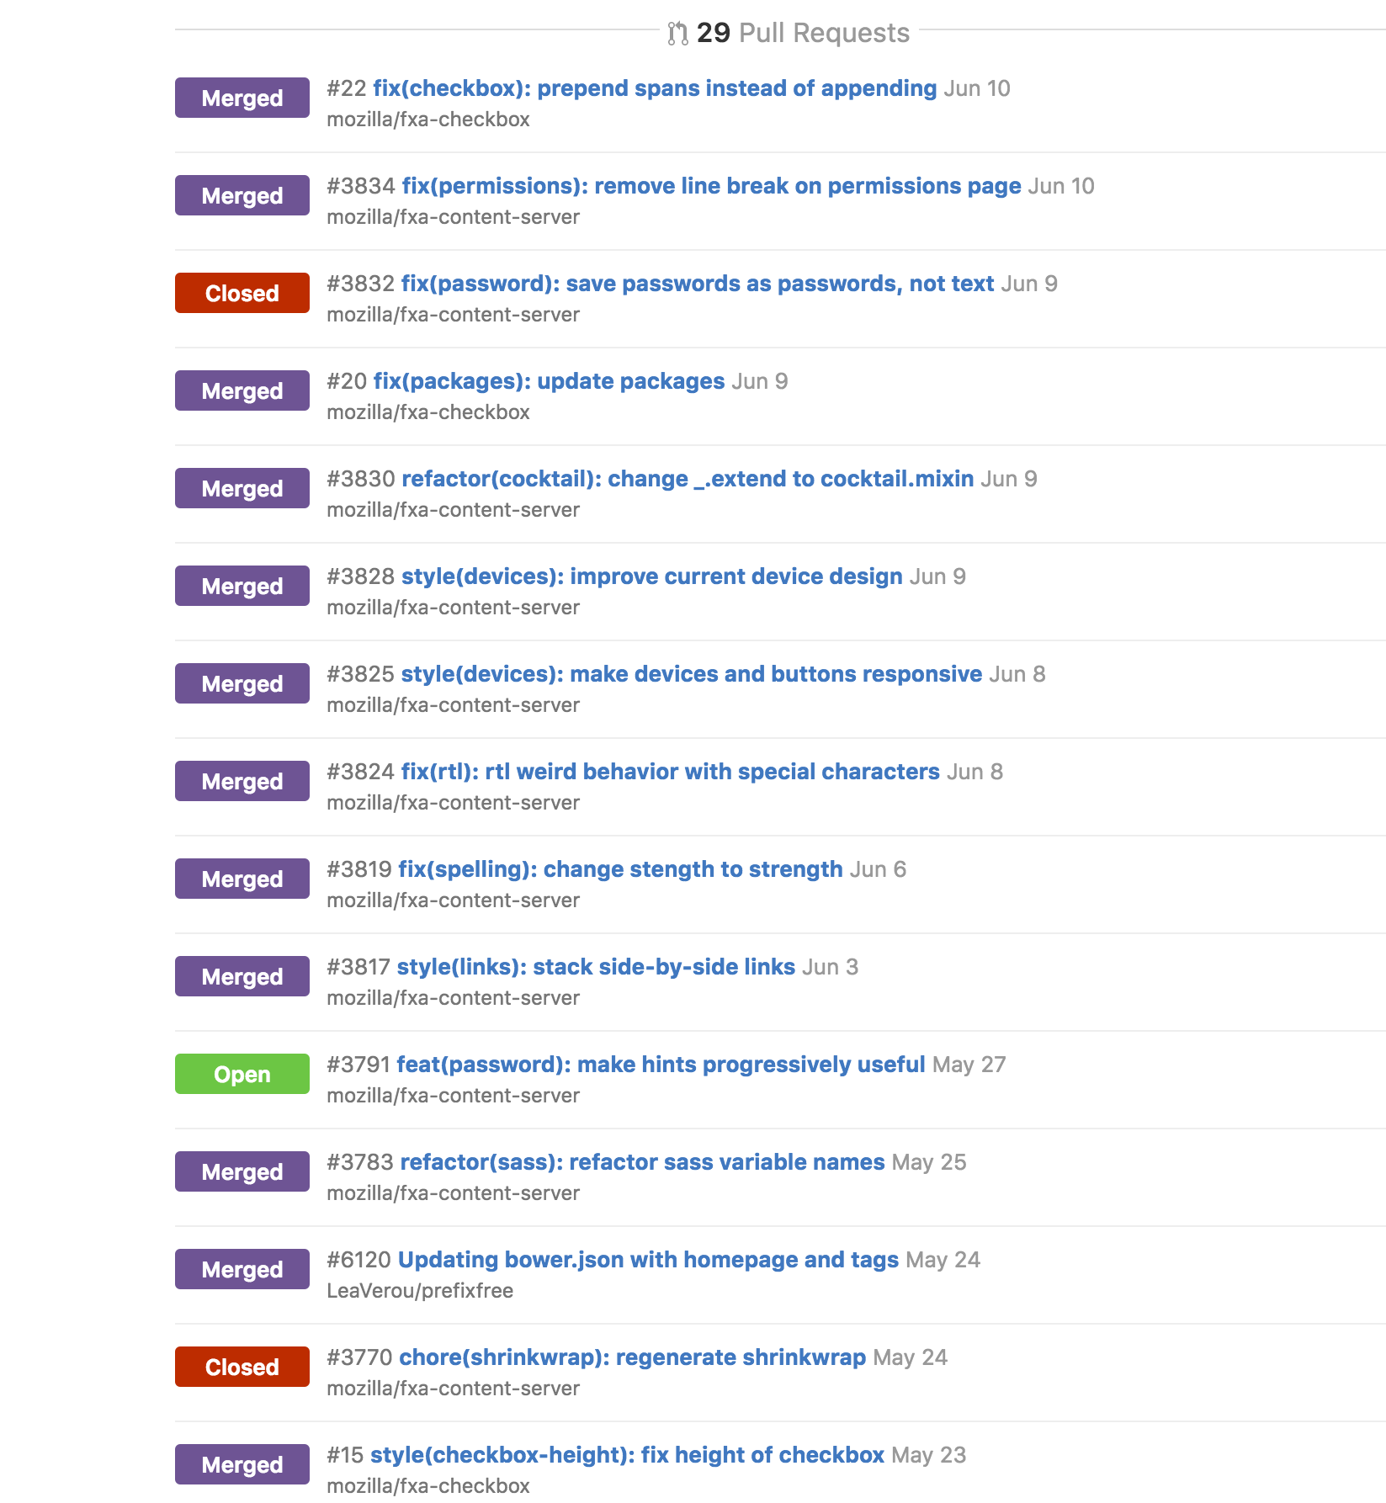
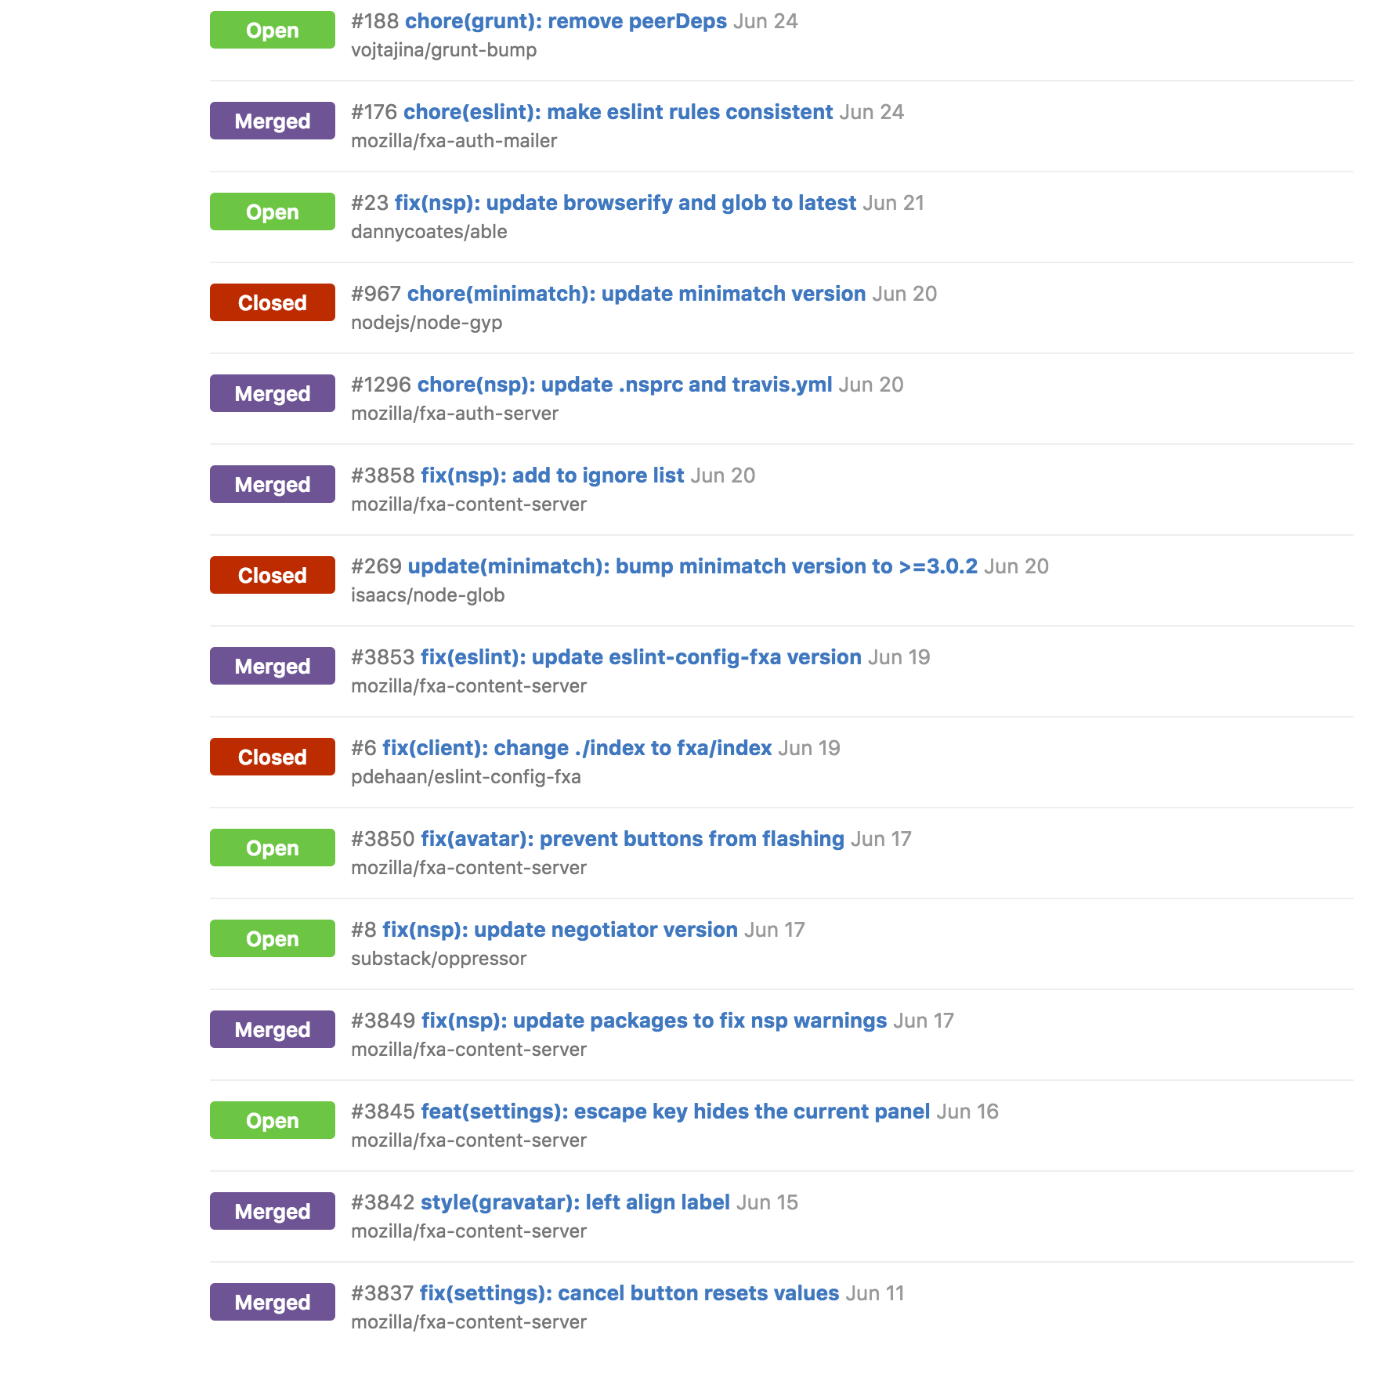
So how did my Summer go?
I worked on a bunch of bug fixes, 47 to be exact.

Slide 5
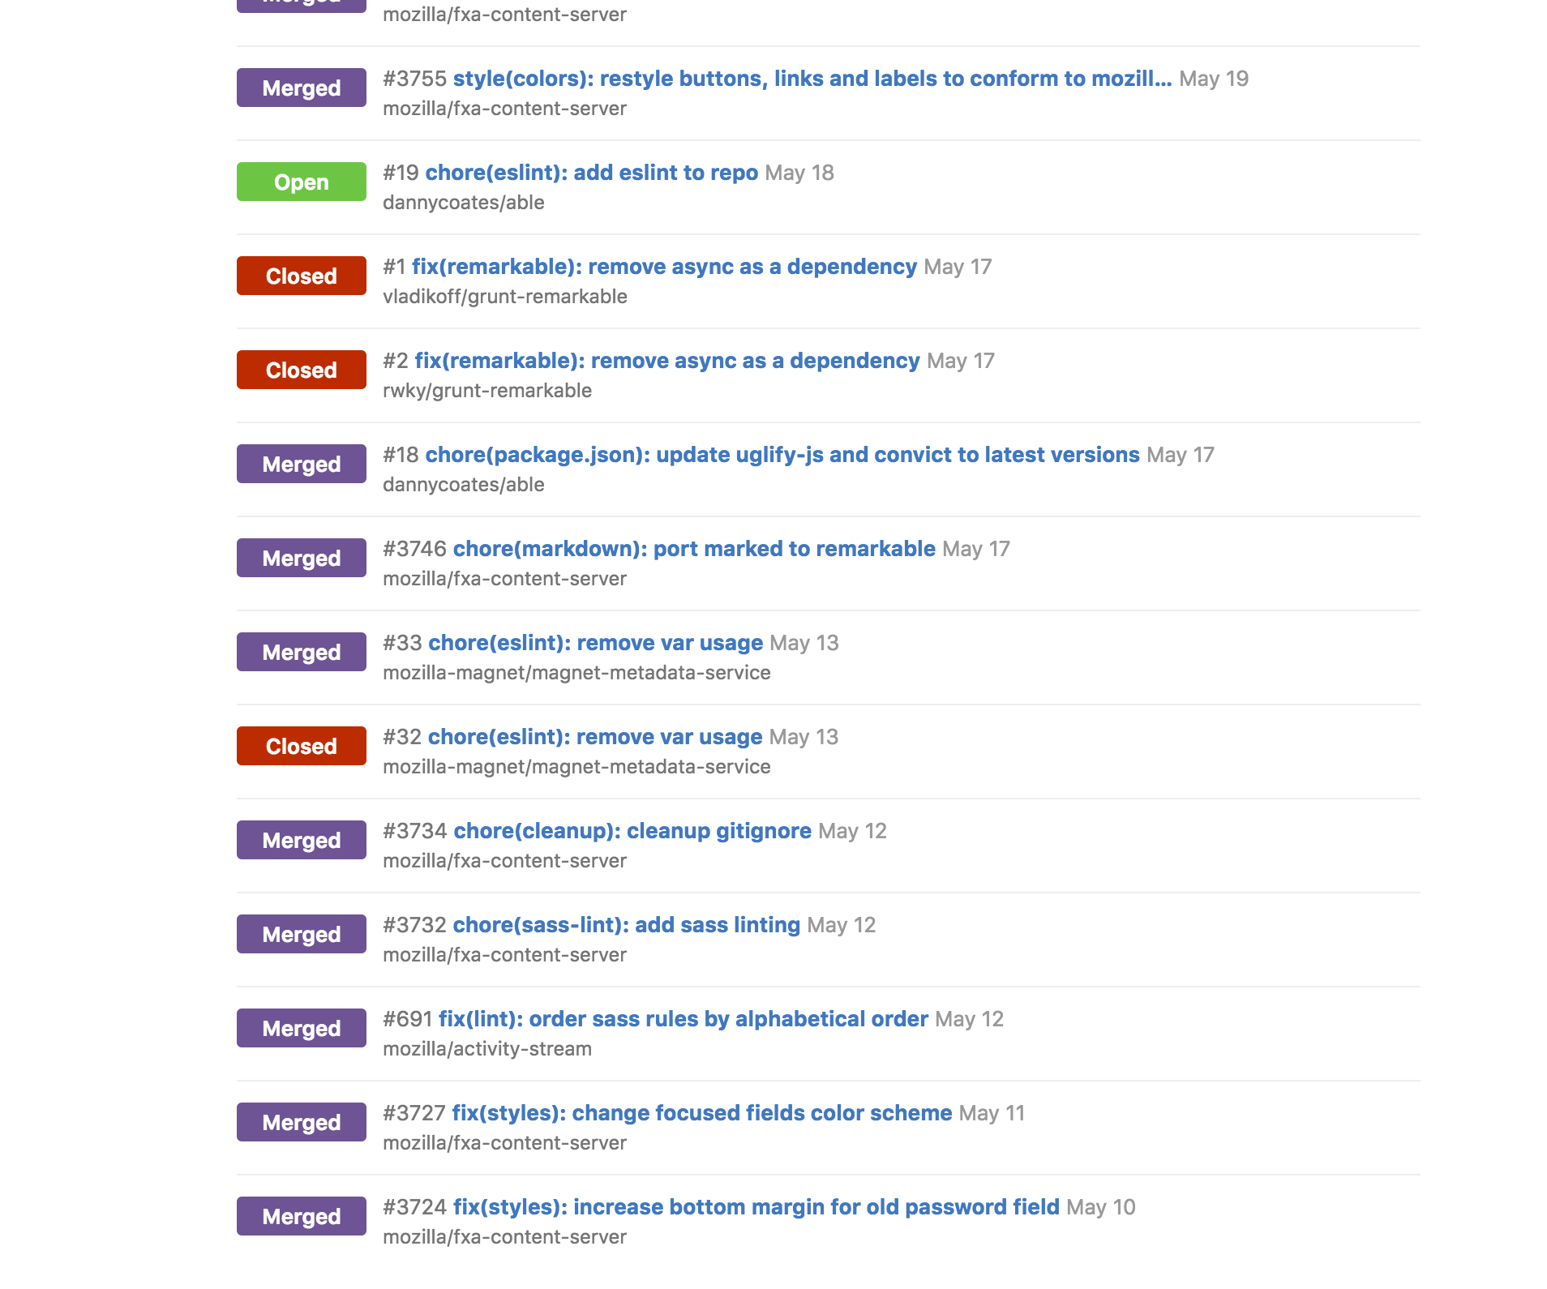
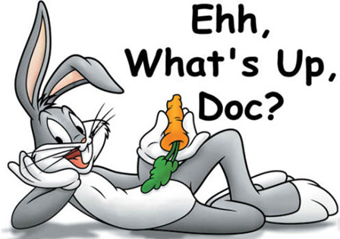
Just bugs?
Why you hating on bugs? Bugs’ important, listen to the guy on the right.

Slide 6
Well.. And?
Plenty of small bugs like:
ESLint fixes
Sasslint fixes
Node Security Advisories – Updating dependencies
Sometimes going 4-5 repos downstream
Style fixes, like
Widths, heights and the like
Stacking links
Making devices view responsive
Using ultra cool CSS stuff like `fit-content` and `calc`
Weird RTL issues
Aligning fxa-checkbox
Preventing buttons from flashing on page load (not FOUT)
Adjusting clickable areas in forms and links

Slide 7
Any features…?
Ok, and some small handy features:
Added sass-linting to our repos
Making FxA settings panels more keyboard accessible
Unified the styles used in FxA with those in Mozilla’s Style Guide for buttons, colors, links and text
I also refactored our files, ensuring that:
We used better variable names in our sass files
We used better variable values in our sass files
We ported to Cocktail from Underscore, completely

Slide 8
Did you actually do anything useful? Like a project?
Surprisingly, I actually did work on 3 really nice projects this Summer:
Password hints – Making better passwords a reality
Geolocation data in e-mail communication
Geoprofiling based on user history

Slide 9
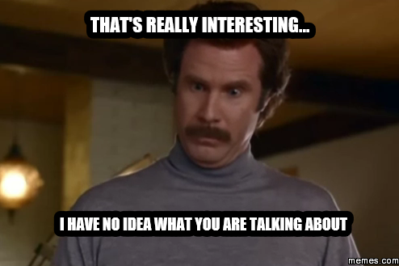
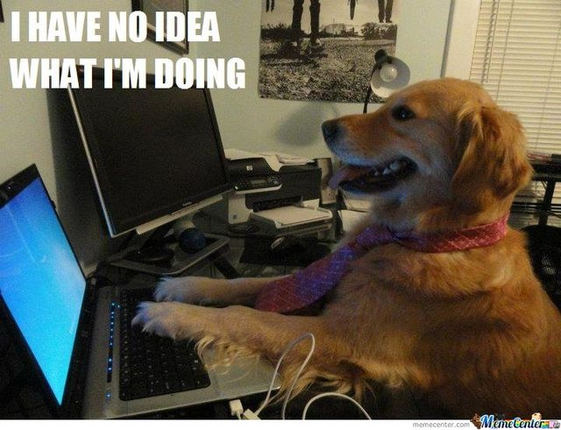

So how was my Summer you ask?
One word. Awesome.
Ranging from:
Hearing about the ideas I was going to work on and starting the work.

Slide 10
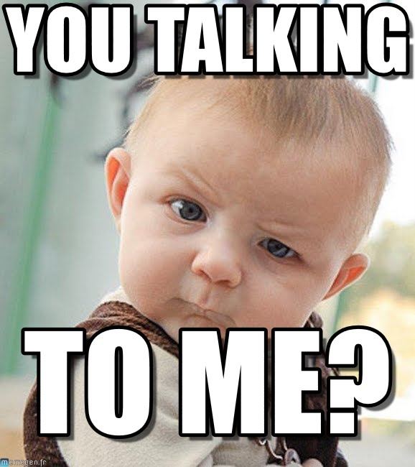

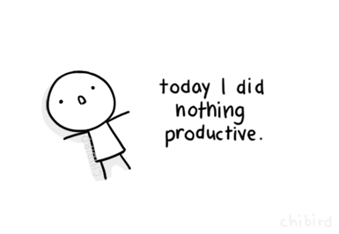
To..
Reading reviews telling me to change something.

Slide 11

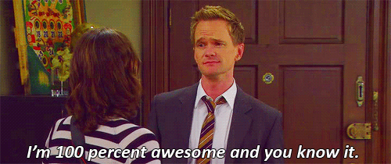

And finally to..
When I finally got a PR to land.

Slide 12
Thanks to..
The Cloud Services Team:
Chris Karlof (ckarlof) – For all the projects and advice (and dinners).
Ryan Kelly (rfkelly) – For the security projects.
Edwin Wong (edwong) – For all the 2FA support and travel stuff.
John Morrison (jrgm) – For all the support and meetings.
Ryan Feeley (rfeeley) – For all the UX guidance.
John Gruen (jgruen) – For the extremely cool logos (and css help).
Daniel Coates (dcoates) – For helping me in Whistler.
Phil Booth (pb) – For that awesome accent.
Edouard Oger (eoger) – For the pre-push hook that made me commit lesser styling errors.

Slide 13
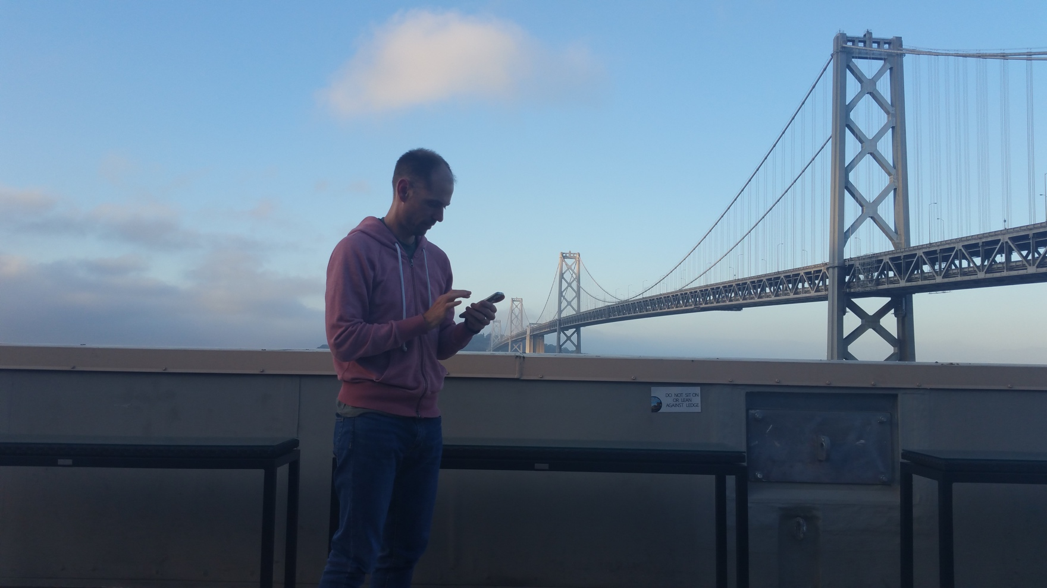
Special Thanks to..
Shane Tomlinson (stomlinson) – My Mentor and Guide
For being patient with me, and helping me out everyday, and almost everything else this summer ☺ Thanks for all the sacrifice, Shane!!!

Slide 14
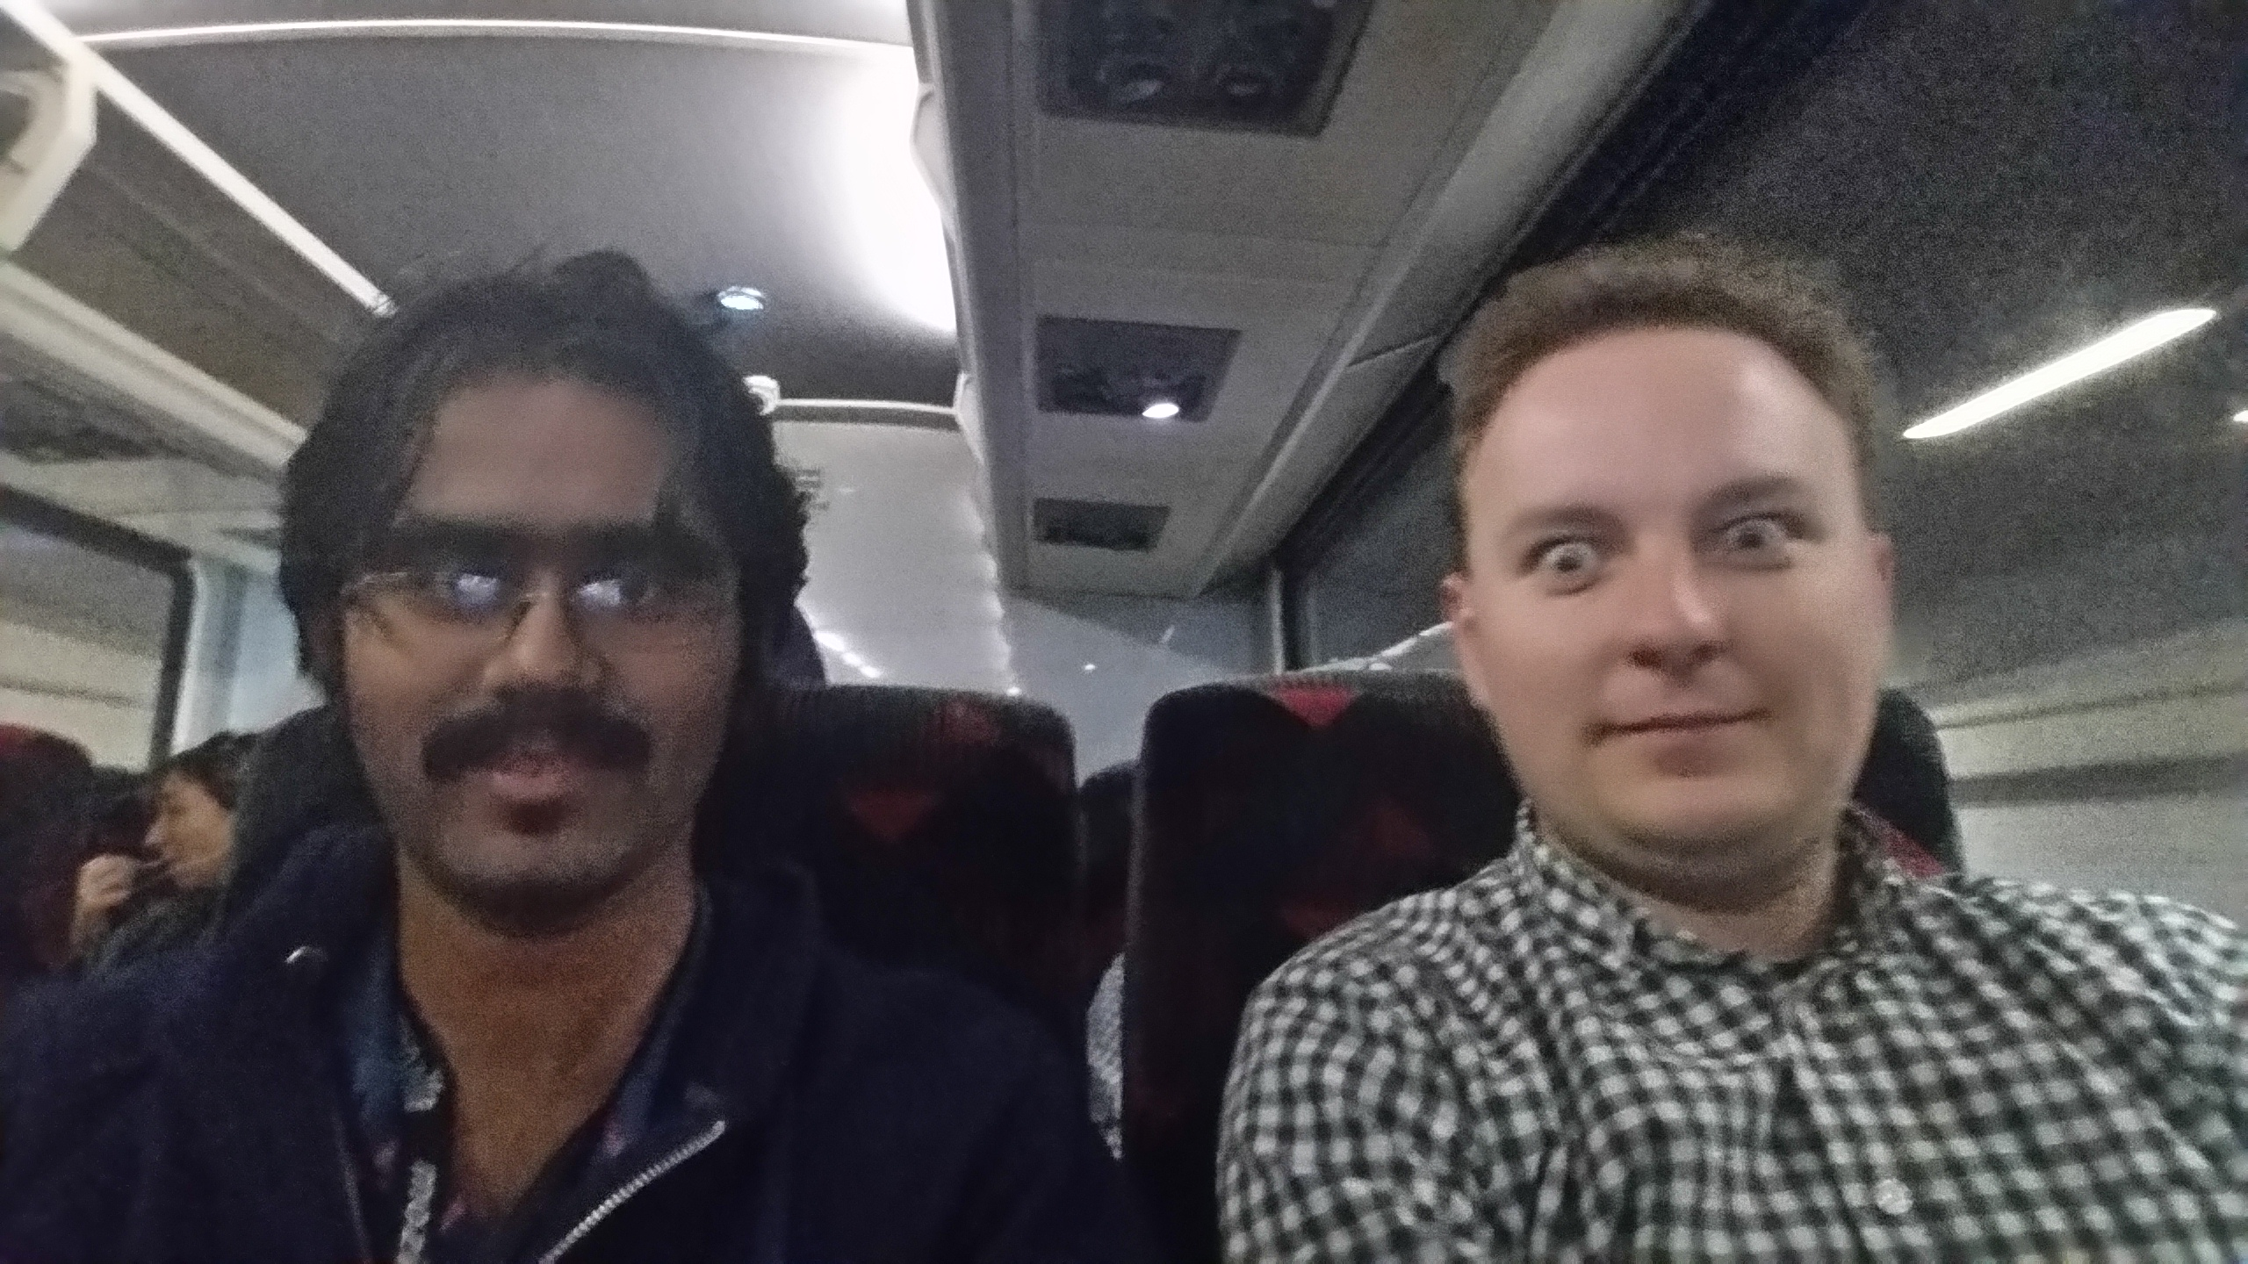
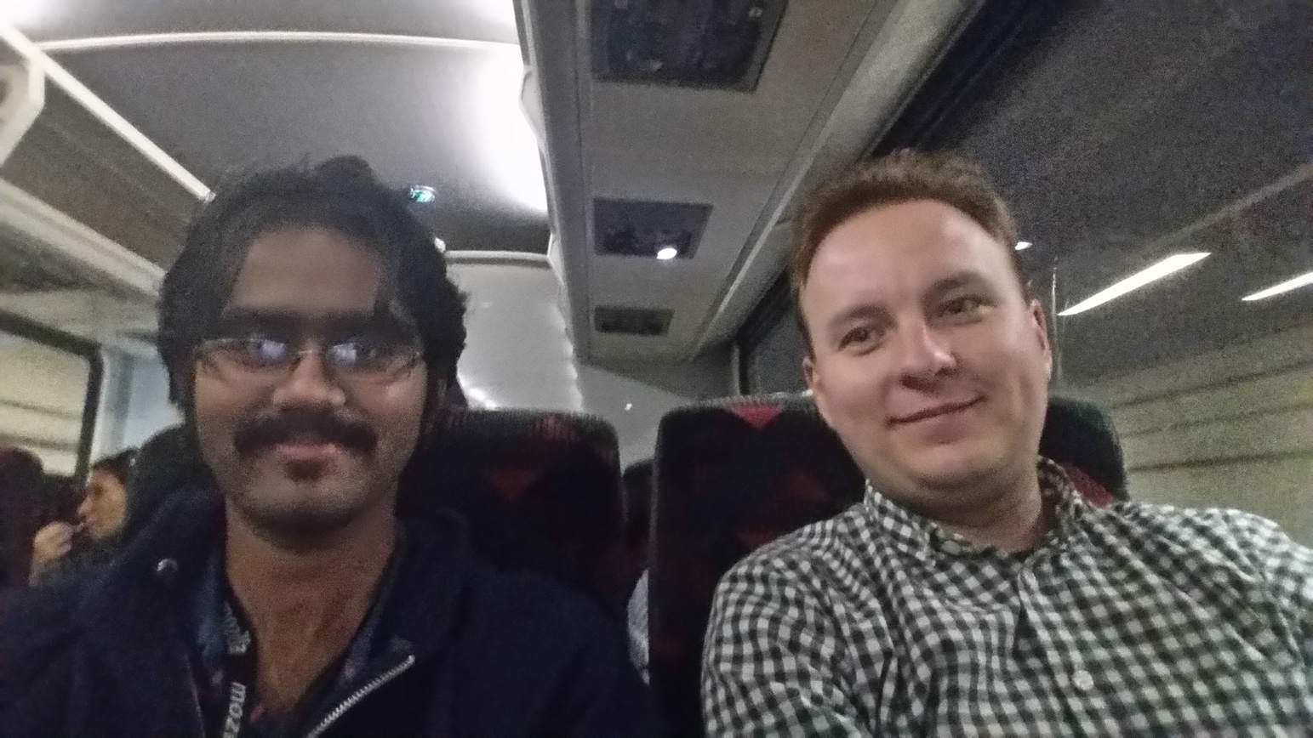
And..
Vlad Filippov (vladikoff) – The Review man.
For the countless reviews and feedback on every push ever made. Thank you so much Vlad! ☺

Slide 15
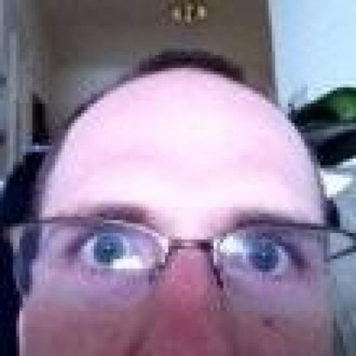
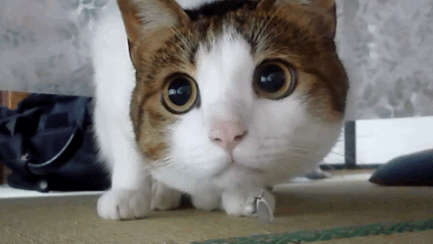
And Finallllly….
Peter Dehaan (pdehaan) – The funniest SW engineer I have met.
NOTHING EVER GETS PAST ME!!! MUHAHAHAHAHAHA!!!
Will you teach me sensei?
Peter was literally the person I ran to, every time I got stuck on ANYTHING, with the kitty face on the right. He put up with my ramblings and rants, and got me the absolute best gifs ever!! Thank you so much Peter, for finding the time to make people laugh ☺

Slide 16
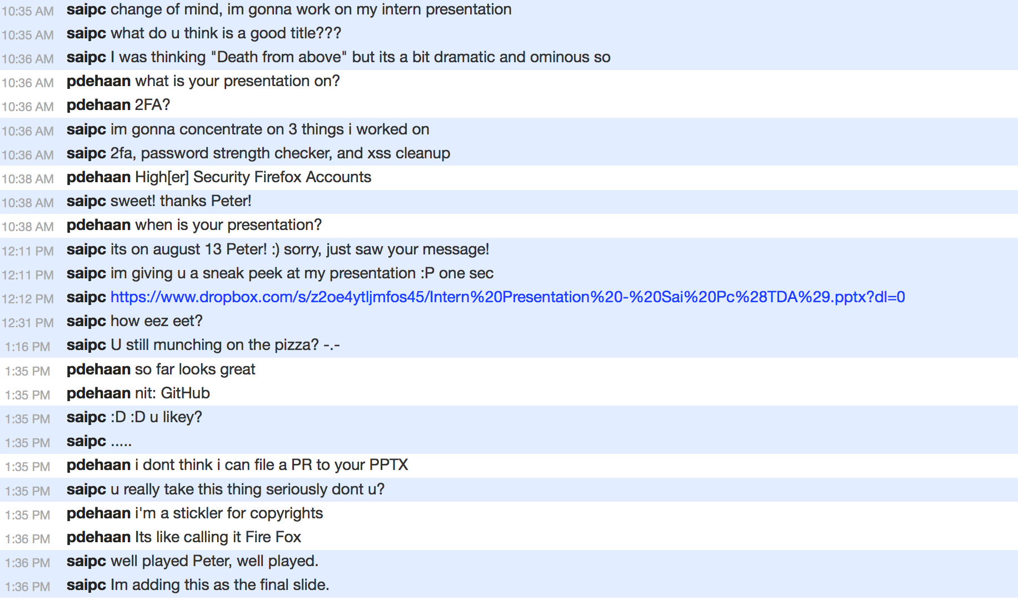
Had to add this T_T
This is why we can’t have good things in life.

Slide 17
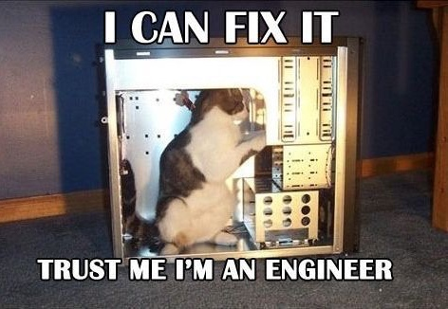
Slide 42: "Answer to The Ultimate Question of Life, the Universe, and Everything".
Questions???
The font used on the slides in general is Corbel(Body). The headings are Corbel(Headings). The slides are a default preset from MS Powerpoint.
The font used on this page is Comic Sans MS(aka most hated font of all times), just to irritate anyone who has an aversion to it. Trust me, I am a web developer.

